Slide 1
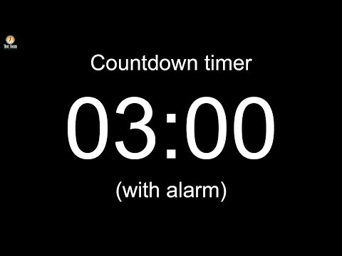
So far, we've learned HTML and CSS and jQuery.
What are some symbols that are commonly used in HTML syntax? What is the general structure?
What are some symbols that are commonly used in CSS syntax? What is the general structure?
What's the difference between HTML, CSS, & jQuery?

Slide 2
define a programming language and identify ways that JavaScript can be used in a website.
Vocabulary: programming language, JavaScript

Slide 3
What is the algorithm for making a peanut butter and jelly sandwich?
An algorithm 算法 is set of instructions and data that are given to a computer.提供给计算机的一组指令和数据。
Notes:
But is it really so simple? Where’s the bread? How do you “spread”? How do you put the two pieces of bread together?
You and I know how to do these things, but try telling a computer how to make a sandwich! When you write an algorithm for a computer, you have to be very specific, and you have to speak the computer’s language. You do this by using a programming language.

Slide 4
We need a “programming” language to make our website interactive!
A program 程序 is a set of instructions and data given to a computer to perform a specific task.提供给计算机以执行特定任务的一组指令和数据
Programming languages 编程语言 are the rules used to create a program.用于创建程序的规则
There are lots of different programming languages and all are used to perform different tasks or solve different kinds of problems:
JavaScript, Python, Java, Swift, PHP, Ruby, C#, C++, etc...
Notes:
Use this as an opportunity to describe front-end vs. back-end web development.

Slide 5
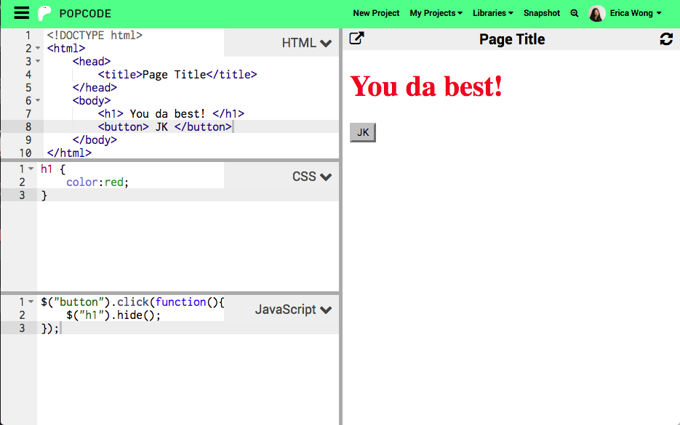
Modern websites consist of:
HTML
CSS
JavaScript
You've probably noticed these three in Popcode!

Slide 6
Modern websites consist of:
HTML
CSS
JavaScript
JavaScript is the 3rd and final box in our coding environment, Popcode.

Slide 7
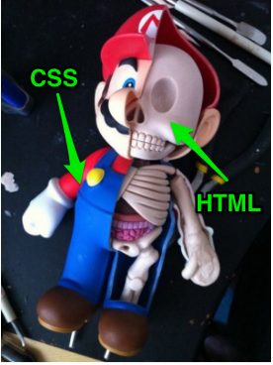
What is JavaScript used for, again?

Slide 8
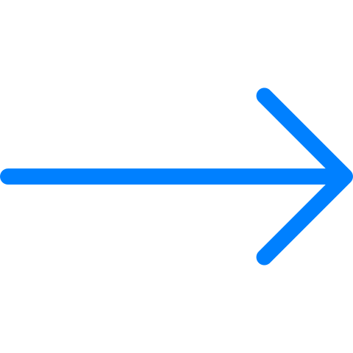
What is JavaScript used for, again?
JavaScript is a programming language that allows for behavior and interactivity on a webpage.
But you've already been using it!
jQuery is a part (a library) of JavaScript.

Slide 9
Your turn to explore JavaScript!
Check out this activity.
Explore the different JavaScript components and see how many puzzles you can solve!
https://popcode.org/?snapshot=ae75df95-617a-4c75-a329-c69760669b83
Notes:
Edit slide if you are using the paper assignment
Walk through the popcode link, open up JS and show students how the code is broken up into sections based on JS concept for this activity. Also read through the first part of the assignment instructions

Slide 10
Choose the answer that best fills in the blanks:
HTML gives your website its (1)______,
CSS gives it its (2)______,
and JavaScript gives your page (3)______.
Style, content, interactivity
Content, style, interactivity
Interactivity, style, content
Content, interactivity, style

Slide 11
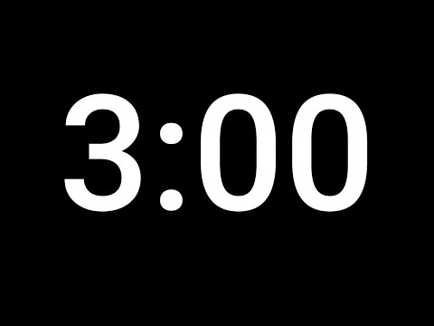
https://popcode.org/?snapshot=ffdb2034-6bf2-405e-96f0-b3e086e80fe8
Open the exercise in Popcode
Change "cute.dog" in the JavaScript tab to your name! What happened?
Notes:
Not all students will be able to complete all the tasks. Spend no more than 5 minutes, this is just a warm-up.

Slide 12
Usernames, locations, the number of likes and hashtags are all types of information that are in an Instagram posts
Apps like Instagram store information like this in variables
Let’s review the Do Now!
Notes:
Teacher Notes:

Slide 13
create a new variable （变量）, store information in it, and read its value（值）.
Vocabulary: variable, declare, let, and value
Notes:
Coders should read aloud the objective.

Slide 14
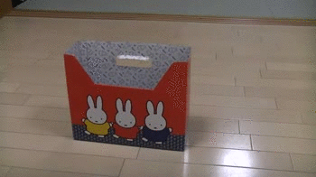
A variable is a placeholder that stores a value.
You can then use the variable’s stored information in your website.

Slide 15
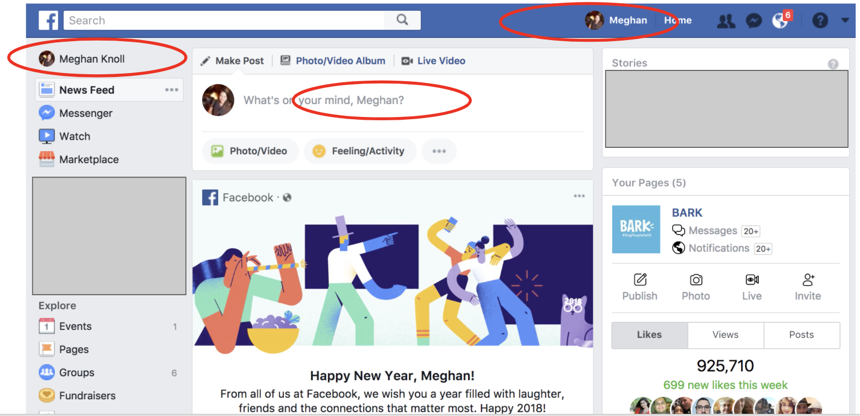
But why are variables useful?

Slide 16
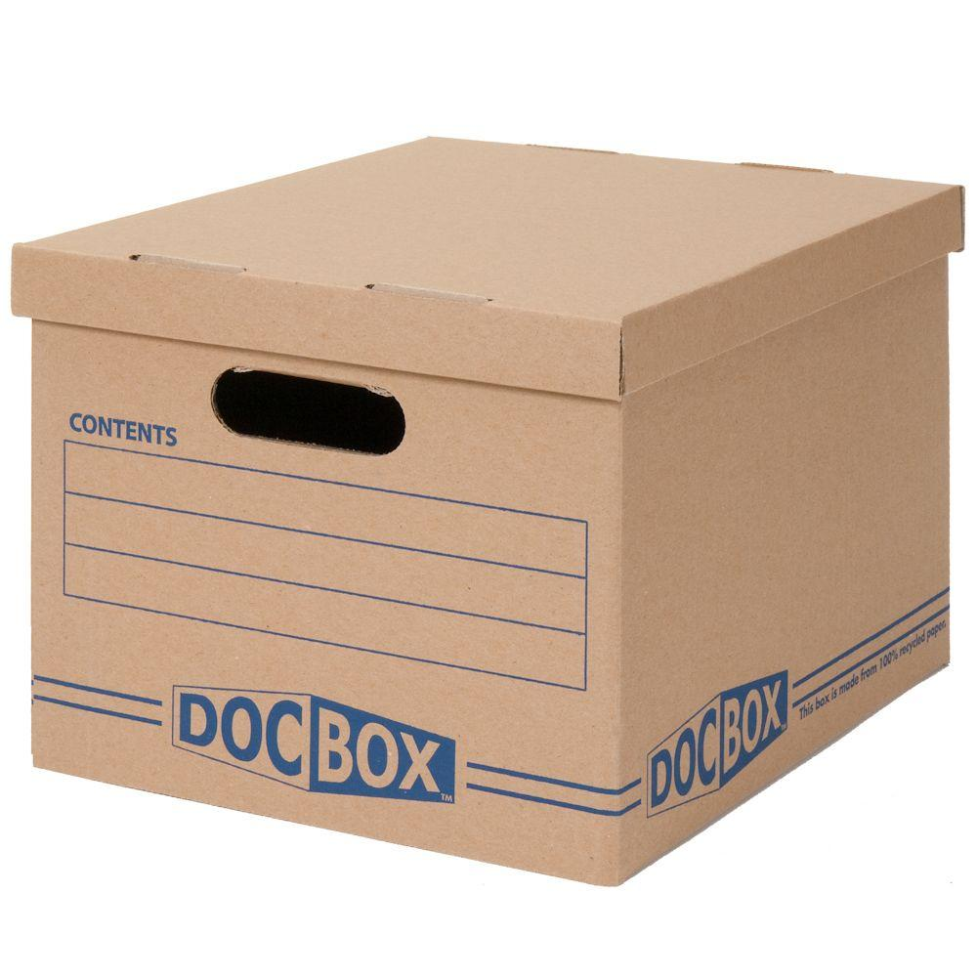
Variables
将变量想像成盒子。
它可以容纳我们想要的任何东西。
我们可以使用关键字let创建此盒子。
let myBox;
myBox
Notes:
Do this exercise live with a mug, box, backpack or anyone physical object you have with you in class. This really helps solidify an abstract concept with something concrete.

Slide 17
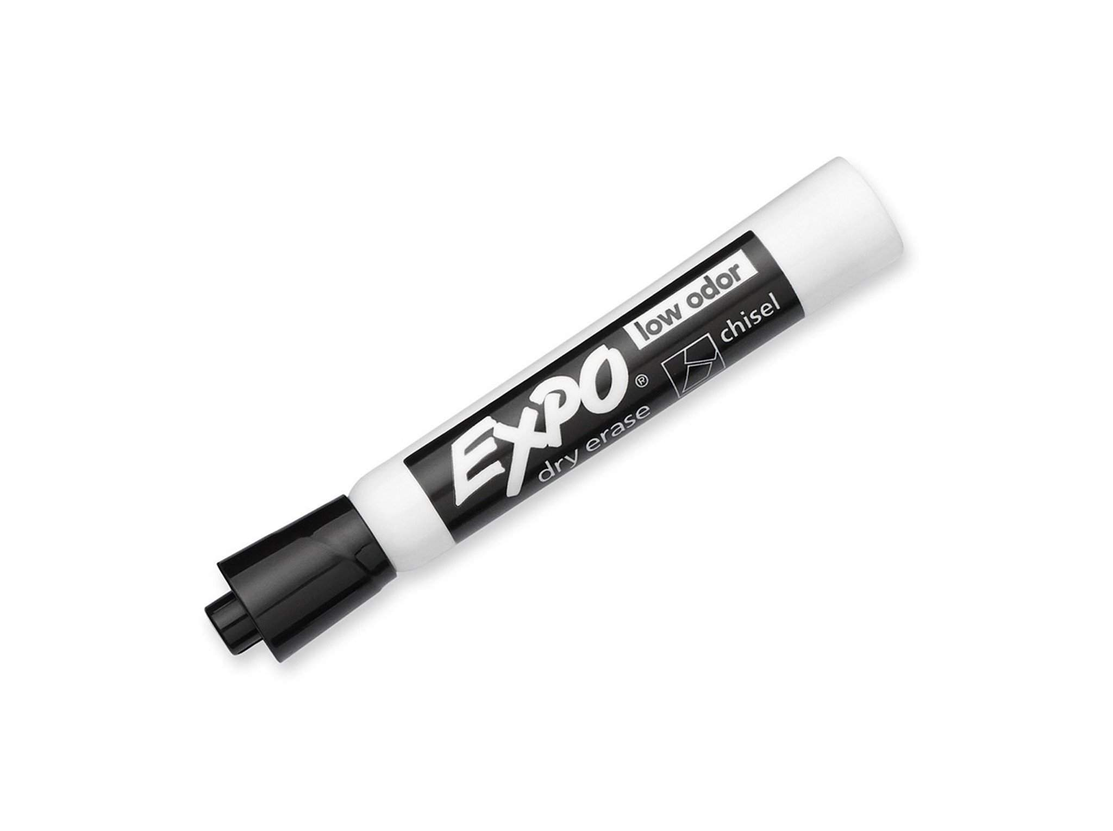
The value of my variable is
inside the box.
myBox = “马克笔";
myBox的值是?
myBox

Slide 18
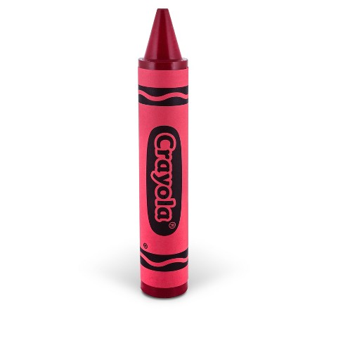
What about now?
myBox = “蜡笔";
What is the value of myBox?
Note: We aren’t changing the box,
just what is inside it
myBox

Slide 19
What about now?
myBox = 5;
5
What is the value of myBox?
记住：我们可以存储任何东西
到变量里
myBox

Slide 20
Variables
因为你不能储存东西
在一个尚不存在的盒子中
您必须先声明一个变量，然后才能使用它。
我们使用关键字let声明新的变量
???
Notes:
\

Slide 21
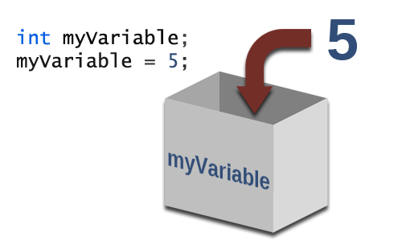
存一个值
Once we declare a variable, we can store any value we want into it.
let myVariable;
myVariable = 5;
Assign the value 5 to the variable variableName
Notes:
Teacher Notes:
Once a variable is declared, it can hold anything! We can leave it empty, or we can fill it with a number, a piece of text, a picture, anything!
The contents of a variable are called its value.
We put a value into the variable by assigning it a value

Slide 22
Declaring a Variable
To create a new variable we must declare it and give it a name:
let variableName;
Keyword
Name you call the variable
Notes:
Teacher Notes:
Before we can start using a variable, we have to declare it and give it a name that we can refer back to
The syntax is pretty easy
The name can be anything! It’s important to use the name to describe what you intend to put into the variable. Don’t just name things “myVariable,” call it something descriptive, like “playerName” or “score”

Slide 23
Storing a Value
We can assign new values to our variable too.
let variableName;
variableName = 5;
variableName = 10;
10
Whichever value is stored in the variable last will be the current value of the variable. How many times did we write let?
Notes:
Teacher Notes:
Once a variable is declared, it can hold anything! We can leave it empty, or we can fill it with a number, a piece of text, a picture, anything!
The contents of a variable are called its value.
We put a value into the variable by assigning it a value

Slide 24
What’s the name of this variable?
What’s the initial value?
let highScore = 20;

Slide 25
What will display on the page?
let highScore = 20;
$(“body”).text(highScore);

Slide 26
What will display on the page?
let highScore = 20;
highScore = 25;
$(“body”).text(highScore);

Slide 27
What will display on the page?
let highScore = 20;
let newScore = 30;
highScore = newScore;
$(“body”).text(highScore);

Slide 28
What will display on the page?
let highScore = 20;
$(“body”).text(“highScore”);

Slide 29
Watch Out! 😱😱😱
Can you spot what’s wrong with this code?
let mysteryValue;
mysteryvalue = 7;
Notes:
Teacher Notes:

Slide 30
Naming Variables
变量可以有很多不同的名称！
但是，名称最好有意义，与您将在其中存储的内容有关：
let numberStudents = 16;
let enemy = "Goomba";
let avgGPA = 3.14;

Slide 31
Naming Variables
变量名称有两个主要限制：
他们不能以数字开头
不能是关键字
let 100bills = 10;
let let = "Hello,students!";

Slide 32
Keywords
关键字是特殊的词，表示JavaScript中的某些特定内容，并且在诸如Popcode之类的代码编辑器中键入时始终为彩色。
let是一个关键字示例。
我们还看到了哪些其他关键字？

Slide 33
How do I declare a variable? How do I assign a new value to it?
Coders will …
create a new variable, store
information in it, and read its value.
Notes:
Say:
Remember, our goal today was to…

Slide 34
After this code runs, what is the value of myFruit?
"cherries"
"pineapple"
"apple"
let
Notes:
Teacher Notes:

Slide 35
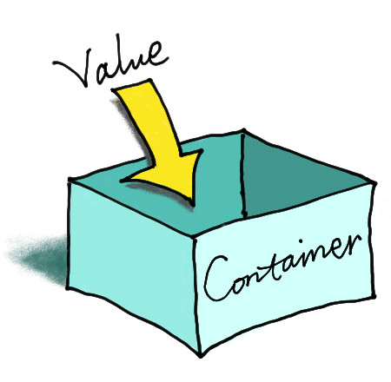
On a piece of paper:
Declare a variable named greeting and give it the value “Hello!”
Declare another variable named age and give it the value 15.
Paper
Notes:
Teacher Notes:

Slide 36
Open popcode:
声明一个名为greeting的变量，并将其值设为“ Hello！”。 声明另一个名为age的变量，并将其值设置为15。
Computer
Notes:
Teacher Notes:

Slide 37
Let’s Practice Together
Declare a variable, assign a value to it, and display its current value.
https://popcode.org/?snapshot=ba42cde2-7434-4e0a-831a-b8de92c9442d

Slide 38
identify strings and numbers as data types and differentiate between them.
Vocabulary: types, number, and string
Notes:
Coders should read aloud the objective.

Slide 39
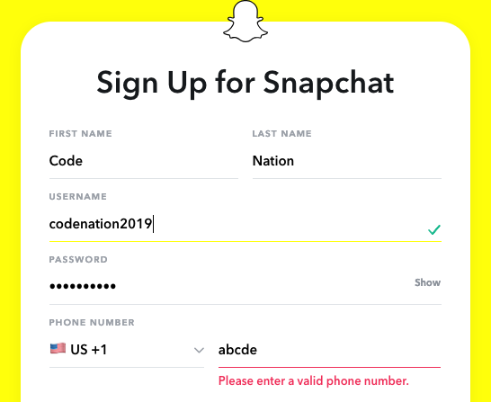
Connections
Have you ever tried to sign up for something and gotten an error message?
How does Snapchat know that this is not a phone number?
Notes:
Connection slide --
ask students why would a computer need to know the type of a data?

Slide 40
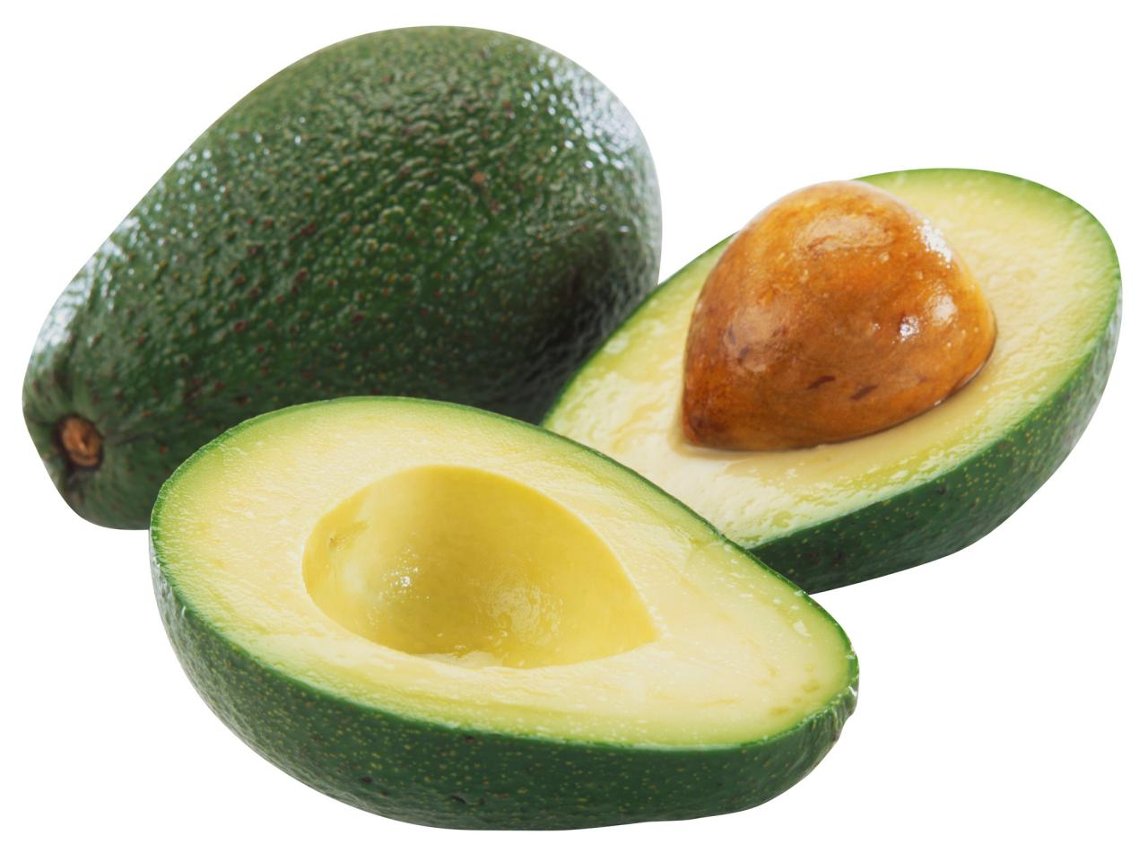
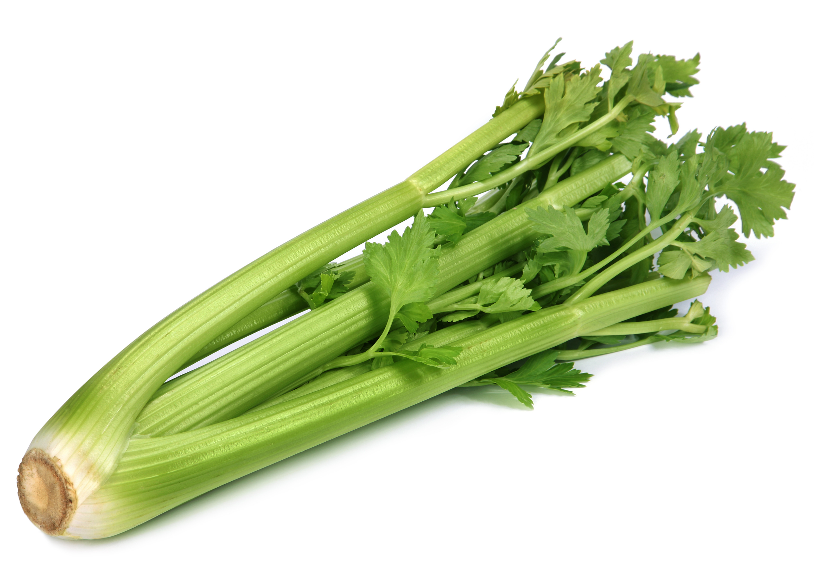
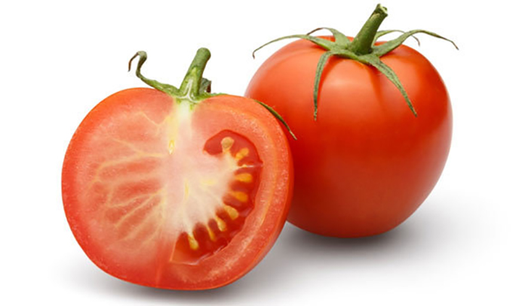
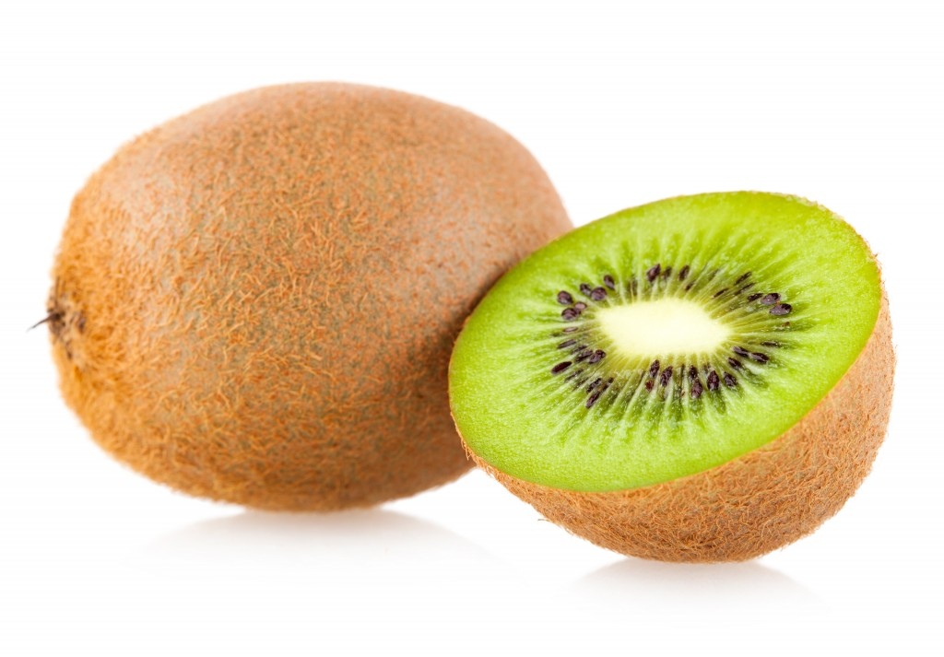
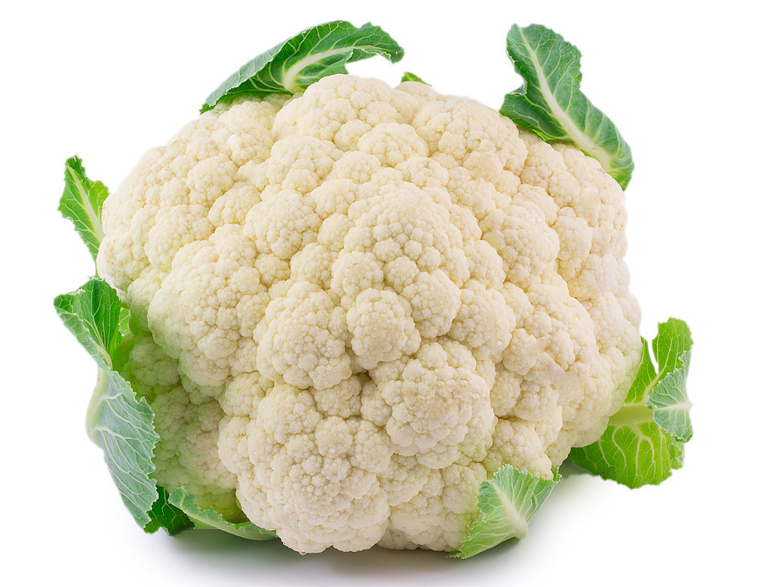
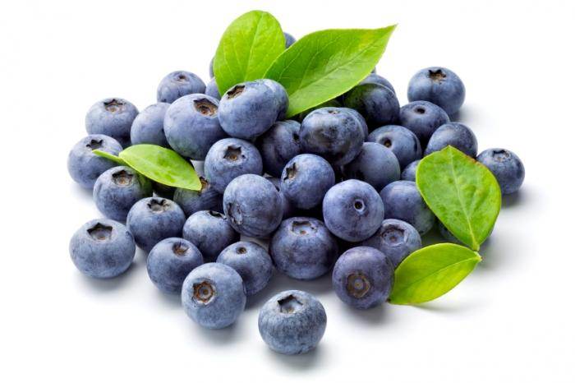
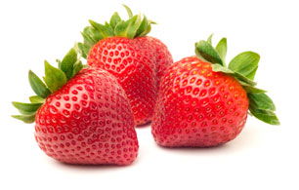
Type
这些是什么类型的食物-水果或蔬菜？
Notes:
Teacher Notes:
This slide should be given in presentation mode, to allow the different images to appear
SEE CORRECT ANSWERS BELOW:
Cauliflower = vegetable
Strawberry = fruit
Kiwi = fruit
Blueberry = fruit
Celery = vegetable
Avocado = fruit
Tomato = fruit

Slide 41
Data Types
就像您知道给定食物的类型一样，Javascript也知道变量中给定值的类型。
这些数据类型很重要，因为Javascript具有关于它们如何交互的某些规则。
Notes:
Teacher Notes:
The type of something doesn’t tell you what the thing actually is, but it gives you a sense of what qualities it might have and how to manipulate or use those qualities
Javascript knows what value a variable holds at any time. But it also knows what type of data it is.
Javascript has certain rules about how different data types can interact. This is important because it allows Javascript to figure out when something is wrong in your code and let you know.

Slide 42
Data Types
There are many different data types in Javascript,but we’re going to focus on two:
Numbers（数字）
7
3.14
0.3
-42
Strings（字符串）
"2e8ay"
"Hello, students!"
" "
"Anything btwn quotations"
Notes:
Teacher Notes:
You might ask the students to tell you what are some of the differences they notice between the two types

Slide 43
Numbers
No commas: 1,234,567 should be 1234567
May start with a _+_ or _-_ : -2
May include a decimal point: 1.99
Notes:
Teacher Notes:

Slide 44
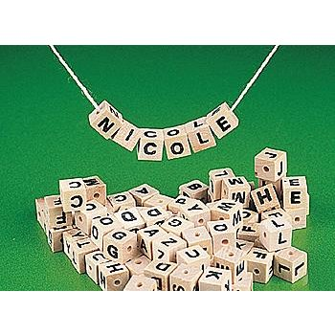
Strings
总是被“引号”包围
可以为空“”
一堆字母，空格和标点符号都用字符串绑在一起，并用引号引起来
" "
Notes:
Teacher Notes:

Slide 45
Number or String?
"14"
3.18314
-28.8
7
"Hello"
""
"0.382718"
Notes:
Teacher Notes:
Rapid fire these - have the whole room call out whether these are strings or numbers
Remember that strings will ALWAYS be surrounded by quotation marks. Even if it looks like a number, if it’s got quotation marks around it, Javascript considers it a string

Slide 46
Raise your hand if...
You've gotten stuck because of an error.
You feel like JavaScript is a little more confusing because things don't automatically appear on the page
You wish you could check your work
as you go

Slide 47
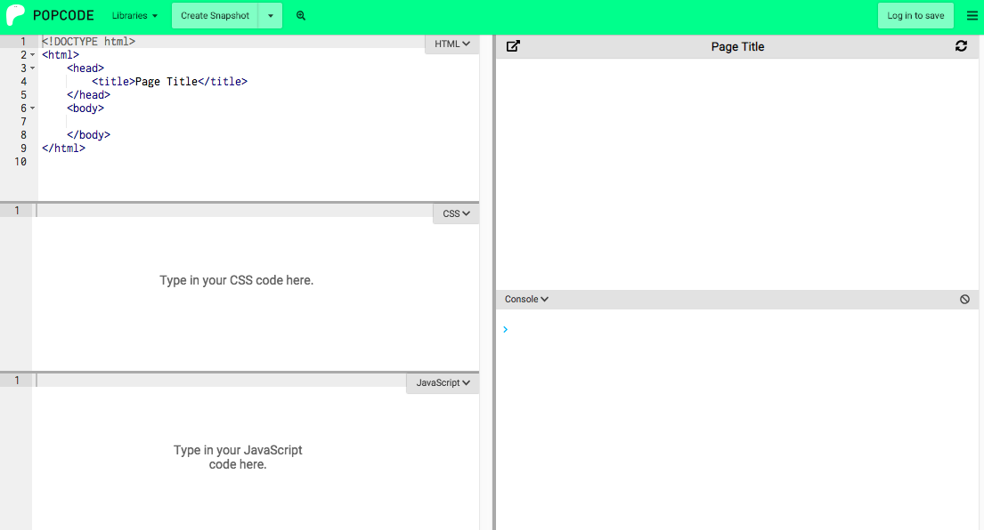
You CAN check your work!
The console is an internal tool that's built into most browsers.
You can access it in popcode!

Slide 48
Console
控制台是仅供开发人员使用的秘密区域
输出到控制台的内容将在页面上不可见，因此用户将看不到它。

Slide 49
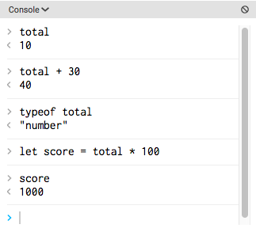
Console
你能做什么呢？
使用console.log（）;
在您的Javascript文件中打印东西到控制台
也可以直接在控制台中测试不是主程序一部分的新代码

Slide 50
Console Demo
Let’s open the console in a new popcode.
在JavaScript中，我们声明一个名为egg的变量并将其值设置为“ chicken”。
现在让我们在console.log（）中使用typeof egg。
控制台中显示什么？
您认为typeof有什么作用？
现在，让我们尝试使用带有egg变量的console.log（）。
您认为console.log（）有什么作用？
Notes:
Teacher Notes:
This is the first time students are experiencing the console so don’t worry about having them spell out this code for you. You should lead them through what you are doing and reading the output in the console.

Slide 51
use operators（操作符） to manipulate data.
Vocabulary: operators
Notes:
Coders should read aloud the objective.

Slide 52
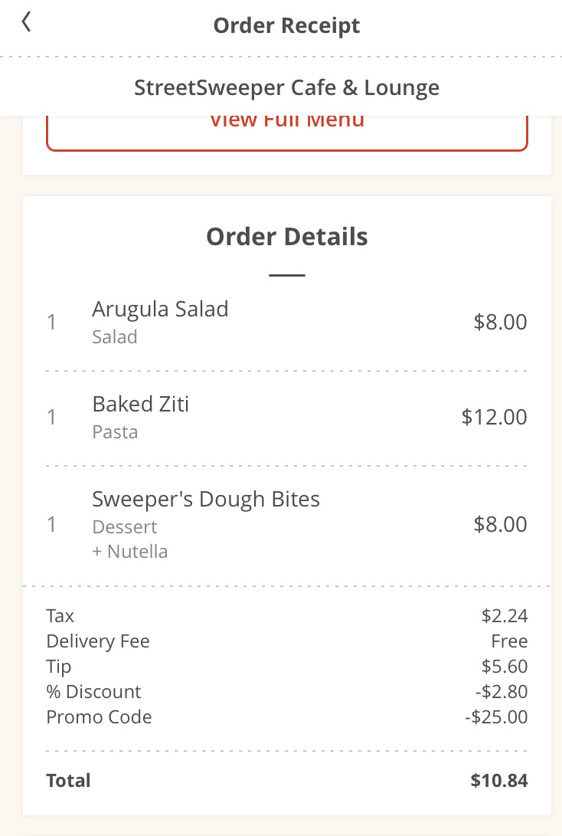
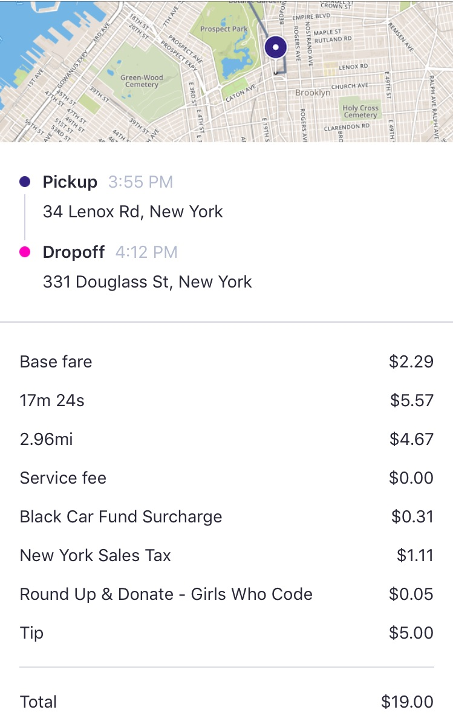
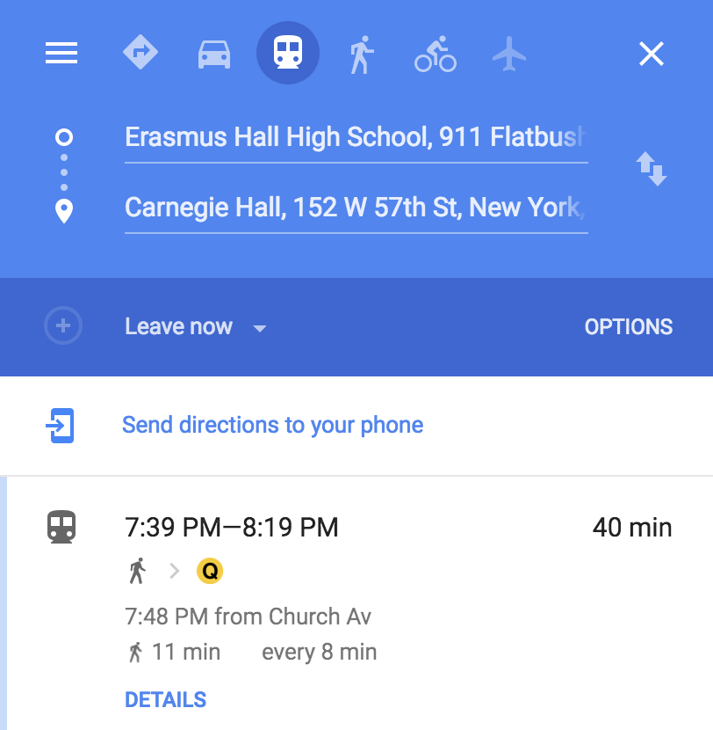
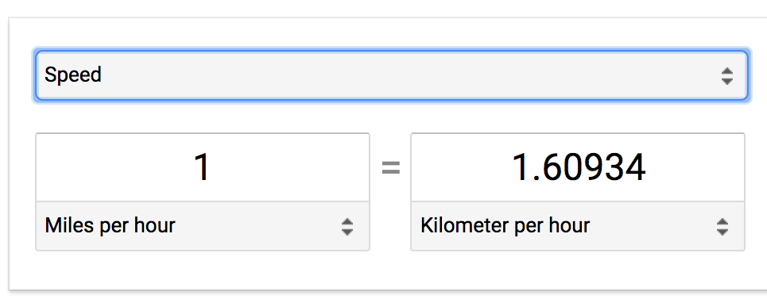
Connections
What kind of operators are being used here?
Notes:
Teacher Notes:
Order receipt: addition and subtraction (promo code)
Ride receipt: addition, subtraction (length of ride), multiplication (NYS tax)
Google Maps: subtraction
Convertor: multiplication or division

Slide 53
Operators
为了执行基本的算术运算和操作代码中的变量，我们使用称为运算符的符号。
我们正在学习的四个运算符是
加，减，除和乘：
+ - / *
Notes:
Teacher Notes:
Asterisk for multiplication may be new to students

Slide 54
Operators
Operators behave just like you would expect them to in math
let points = 15;
let bonus = 3;
points + bonus is equal to 18
points - bonus is equal to 12
points / bonus is equal to 5
points * bonus is equal to 45
Notes:
Teacher Notes:
There are ANIMATIONS. Ask students what the answers are and fill it in on the board or you can click ahead to reveal the answers

Slide 55
Operators
Operators also follow the order of operations
(or PEMDAS) like in math
let points = 5;
let bonus = 3;
let multiplier = 2;
points + bonus * multiplier is equal to 11
Notes:
Teacher Notes:
Ask students what the answer is and fill it in on the board or you can click ahead to reveal the answers
If you’re unfamiliar with PEMDAS, it is a common acronym to represent order of operations: Parentheses, Exponents, Multiplication, Division, Addition and Subtraction.

Slide 56
Operators
We can use parentheses to emphasize which operator should go first (just like in math)
let points = 5;
let bonus = 3;
let multiplier = 2;
(points + bonus) * multiplier is equal to 16
Notes:
Teacher Notes:
Ask students what the answer is and fill it in on the board or you can click ahead to reveal the answers

Slide 57
Operators
我们一直在对数字使用运算符，但是对于字符串呢？
只有+运算符适用于字符串：
let word1 = "pan";
let word2 = "cake";
word1 + word2 is equal to "pancake"
Notes:
Teacher Notes:
If a student asks what happens if you use an operator other than + or what happens when you add a string and number together? Tell them to try it in class and see what happens

Slide 58
Concatenating Strings
当我们将字符串放在一起时，我们将它们串联起来。
可以串联两个以上的字符串：
let first = "Kanye";
let space = " ";
let last = "West";
first + space + last is equal to "Kanye West"
Notes:
Teacher Notes:
Emphasize the importance of space and how it changes the final result

Slide 59
Can we use operators to combine different data types?
5 - "cat" =
Notes:
Teacher Notes:
Imagine your friend asks you what the answer to 5 - “cat” is. It doesn’t make sense, right? That’s because 5 and “cat” have different types, and there’s no clear way to subtract them.
In the same way, Javascript can let you know when you’re trying to do something that doesn’t make sense.
If we try this in the console, Javascript prints out “NaN” or “Not a number,” which basically means that Javascript has no clue what you’re trying to do.

Slide 60
Complete the Operators Worksheet.
Let's do the first 2 together.
If you finish early, use the console to check your answers.
5 + 4
"Michelle " + "Obama"
Notes:
Teacher Notes
Ask students not to have their laptops open or use their computers while doing the worksheet.
Students are encouraged to talk with their seatmates to solve the problems together
The * problems are bonus problems, students are not expected to finish these
If most students finish and you have time, review the answers. When you are reading the problems, say them like this: "Problem C. I'm declaring a variable num1 and assigning it the value of 3. I'm declaring the variable num2 and assigning it the value of 4. I'm declaring the variable num 3 and assigning the value of num1 + 4. What is the value of num2?"
The reason you are being SO WORDY with your question is you are doing a THINK ALOUD. You want students to see the = as "assigning value" and not equal to… as they are accustomed to in math.
Show two different ways they can use the console to check answers. Type the expressions in the JavaScript and use console.log() to print the value of the variable. AND THEN type the expressions in the console to print the results.

Slide 61
5 + 4
"Michelle " + "Obama"
let num1 = 5; let num2 = num1 + 4
let num1 = 3; let num2 = 4; let num 3 = num1 * num2;

Slide 62
let first = "Peanut"; let second = "Butter"; let sandwich = first + second;
let pizza = 8; let perPerson = 2; let dinner = pizza / perPerson;
let birthdayMoney = 500; let phone = 400; let money = birthdayMoney - phone;
let points = 5; let bonus = 2; let factor = 10; let score = points + factor * bonus;

Slide 63
let points = 5; let bonus = 2; let factor = 10; let score = (points + factor) * bonus;
let special = ", "; let shout = "Hooray"; let name = "Maria"; let cheer = shout + special + name
"5" + "4"
let first = "Steph"; let last = "Curry"; let MVP = last + "," + " " + first

Slide 64
How do we know the difference between strings and numbers?
Name 4 operators
Coders will …
identify strings and numbers as data types and differentiate between them.
Coders will …
use operators to manipulate variables.
Notes:
Say:
Remember, our goal today was to…

Slide 65
Which of the following evaluate to numbers?
65 number 数字
“65” 字符串
“Sixty Five” 字符串
6 + 5 = 11 数字
“6” + “5” = “65” 字符串
2, 3, 5
1, 4, 5
All of the above
1, 4
Notes:
Teacher Notes:

Slide 66
Can you identify which variables are holding strings and which variables are holdin numbers?
let eggs = 12;
let food = "ham";
let name = "breakfast";
let pancakes = 3;
let time = "800";
Paper
Notes:
Teacher Notes:

Slide 67
Open popcode. Use typeof to identify which variables are holding strings and which variables are holding numbers.
let eggs = 12;
let food = "ham";
let name = "breakfast";
let pancakes = 3;
let time = "800";
Computer
Notes:
Teacher Notes:

Slide 68
使用input.val（）从输入字段中检索值
Vocabulary: input field, input.val()
Notes:
Coders should read aloud the objective.

Slide 69
输入框

Slide 70
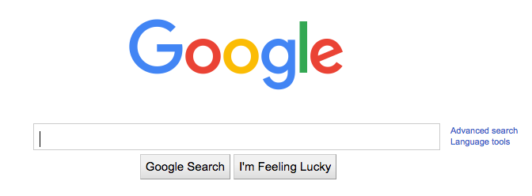
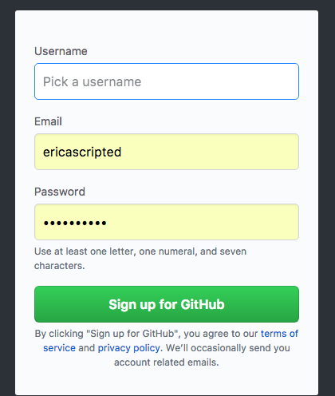
Where have you seen this?
Search
Status
Username
Forms
Notes:
Ask students to share ideas

Slide 71
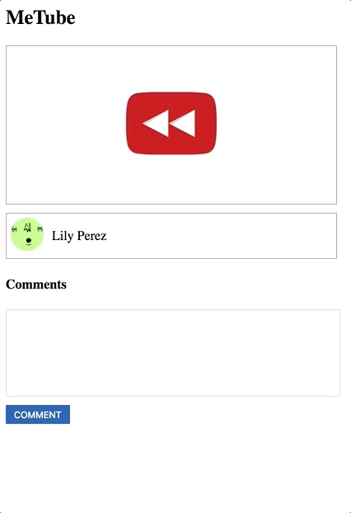
What do we need to build this?
Notes:
Live Demo: https://popcode.org/?snapshot=614974df-45ef-4de6-862c-cefb8efabbc0
Teacher Notes:
“Let’s say we wanted to build a comments form like the one on youtube. What do we need to build the comments functionality?”
Ask students to list out some things they may need.

Slide 72
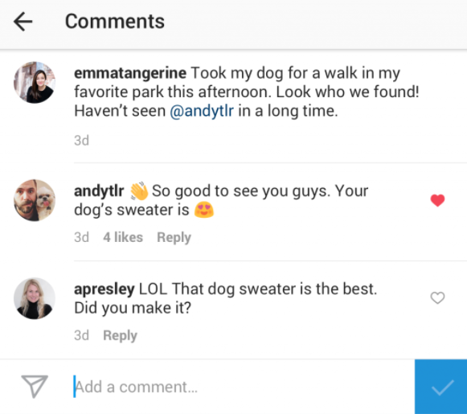
Input Field
input字段是用户可以在网页上键入内容的地方。
.val（）是一个jQuery action（操作），可以检索用户键入的内容。

Slide 73
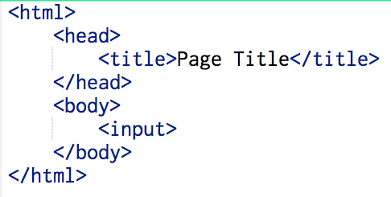
Where have you seen this?
使用html中的<input>标记创建一个输入字段。
没有结束标签！

Slide 74
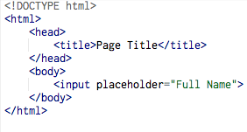
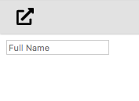
Placeholder attribute
占位符属性提供了简短的提示，用于描述输入字段/文本区域的期望值。在用户输入值之前，该字段会显示简短提示。

Slide 75
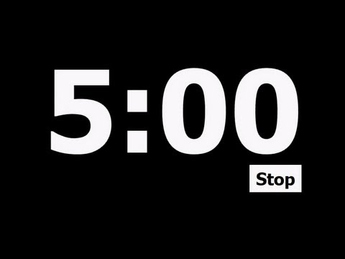
<p>Enter your name:</p>
<input class="userName">
<button class="submit">Go</button>
Let’s make an input field
Like other HTML elements, an input can have class attributes.
Notes:
Teacher Notes:
Show the students what the rendered <input> box looks like, and that you can type in it.

Slide 76
.val() inside a click handler
.val（）捕获用户键入的内容，因此我们可以将其存储在变量中以备后用。
$("button").click(function() {
let message = $("input").val();
});
Notes:
You need to be clear with students that you are declaring a new variable (message) and are assigning it a value - these would be great questions to ask to check for understanding!!

Slide 77
.val() inside a click handler
What is the name of the variable in this code?
$("button").click(function() {
let message = $("input").val();
});
Notes:
You need to be clear with students that you are declaring a new variable (message) and are assigning it a value - these would be great questions to ask to check for understanding!!

Slide 78
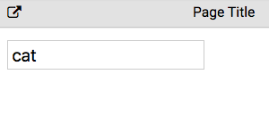
.val() inside a click handler
What is the value of message right now?
$("button").click(function() {
let message = $("input").val();
});
Notes:
You need to be clear with students that you are declaring a new variable (message) and are assigning it a value - these would be great questions to ask to check for understanding!!

Slide 79
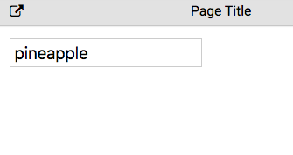
.val() inside a click handler
What is the value of message right now?
$("button").click(function() {
let message = $("input").val();
});
Notes:
You need to be clear with students that you are declaring a new variable (message) and are assigning it a value - these would be great questions to ask to check for understanding!!

Slide 80
.val() inside a click handler
使用jQuery使变量消息显示在文本中。
$("button").click(function() {
let message = $("input").val();
$(".comments").text(message);
});
Notes:
Teacher Notes:
Declare a variable named message and assign it's value to be retrieved from the input. If students get it partially right, help and be very consistent with this "think aloud"
"On the last line, what is the difference between $(".comments") and (message)?"
Desired response: One is a div with the class of comments and the other one is a variable named message.

Slide 81
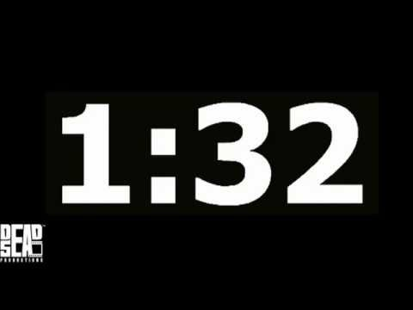
What are the selectors in this code?
$("button").click(function() {
let message = $("input").val();
$(".comments").text(message);
});
Notes:
Teacher Notes:
Make sure to say that you must select the input you want to take the value of --- the same way you must select the element you want to .click on and what to add .text to

Slide 82
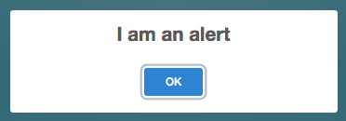
.val() inside a click handler
使用alert（）使变量消息作为警报弹出。
$("button").click(function() {
let message = $("input").val();
alert(message);
});
Notes:
Teacher Notes:
This is the first time students are seeing alert() -- briefly explain it and then show an example in the next slide during guided practice

Slide 83
How do I make space for the user to type?
How do I use the text they typed?
Coders will …
use input.val() to retrieve a value from an input field
Notes:
Say:
Remember, our goal today was to…
use input.val() to retrieve a value from an input field

Slide 84
Given the HTML below, which JavaScript code will retrieve the value of the input field?
<p> Username:
<input class="username">
<button class="btn1"> Submit</button>
</p>
$("input").val();
$(".username").val();
$(".btn1"),val();
a & b
Notes:
Teacher Notes:
Students may need clarification on the directions: they should be writing just the javascript portion to retrieve the info from the input field.

Slide 85
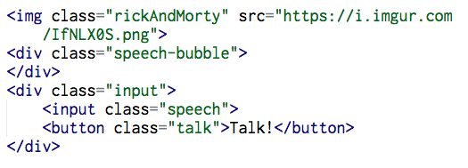
Given the following HTML, write the JavaScript to:
When the button is clicked,
Save the value of the input to a new variable.
Make the text typed in the input field appear in the speech bubble.
Paper
Notes:
Teacher Notes:
Students should be able to accomplish all of these problems. If they are struggling, you need to review variable types

Slide 86
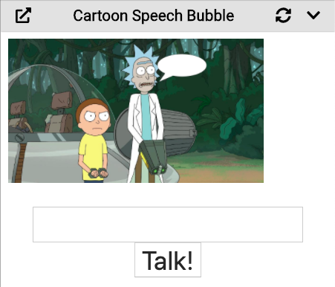
Open popcode.
1.将输入的值保存到新变量。 2.单击按钮时，使在输入字段中键入的文本出现在气泡中。
https://popcode.org/?snapshot=a0f86b81-0cac-45dd-b77b-a86cbdf64a9e
Computer
Notes:
Teacher Notes:
Students should be able to accomplish all of these problems. If they are struggling, you need to review variable types

Slide 87
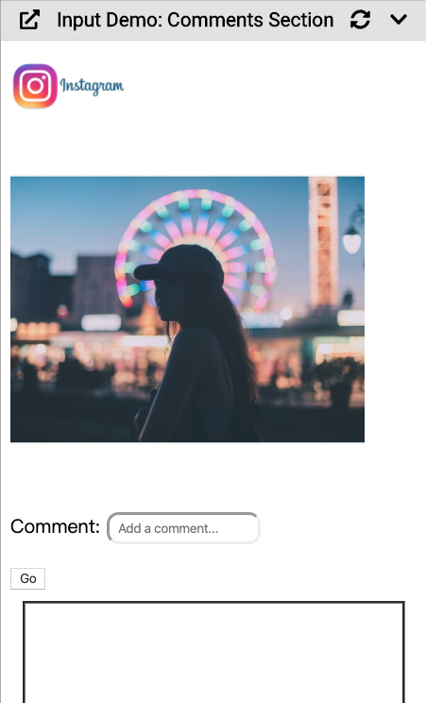
https://popcode.org/?snapshot=c7496a87-3b6d-4107-95ff-00e8af905550
用户评论区
在网页上获取用户评论并显示
Start here!
Notes:
** Have students identify where the input field is created in the HTML-- then ask what they think the placeholder attribute is doing. Show what placeholder does by changing it momentarily
Make sure to demonstrate that you can use the input info in various vays once it’s stored in a variable by using .text() and alert() with to display the input value

Slide 88
Cookie Converter
https://popcode.org/?snapshot=3595205b-55da-433f-852b-9666a97f5291
奥利奥体重
Notes:
Teacher Notes:
Demo this webpage to show what operators can do

Slide 89
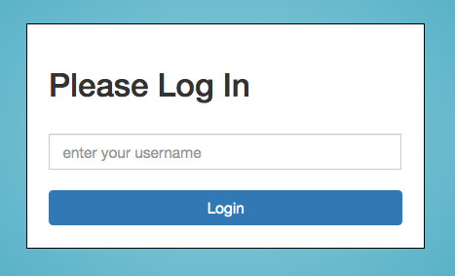
https://popcode.org/?snapshot=88286253-c24d-4db3-aa68-c39cde926786
Update this login page to alert the user’s username when they click the login button.
Mild Medium Spicy

Slide 90
use the .append() jQuery action and string interpolation to add HTML elements to a webpage.
Vocabulary: .append(), string interpolation, backticks
Notes:
Coders should read aloud the objective.

Slide 91
Review: .val() inside a click handler
What is happening on line 2?
What is the value of the variable message?
1 $("button").click(function() {
2 let message = $("input").val();
3 });
Notes:
Teacher Notes:
Use clear vocabulary with students -- you are declaring a new variable (called message) and are assigning it a value - these would be great questions to ask to check for understanding!!

Slide 92
Review: .val() with .text()
Use jQuery .text() with the variable to have the information stored appear on the webpage.
$("button").click(function() {
let message = $("input").val();
$(".comments").text(message);
});
Notes:
Teacher Notes: review what happens in line 3

Slide 93
Using .append()
.append（）将HTML添加到所选元素的末尾。它不会代替已经存在的东西。
$("button").click(function() {
let message = $("input").val();
$(".comments").append(message);
});
Notes:
Compare to .text that replaces everything in selected element with .append() in line 3.
Animation: What will happen each time the user enters a new input and clicks the button? What will appear?

Slide 94
Using .append 附加() to add HTML
您还可以使用.append（）方法在JavaScript中添加新的HTML元素。
.append（）添加的HTML必须写在反引号内。
反引号 ` 可以在键盘上的Tab键上方找到。
$(".add").click(function(){
$(".messages").append(`<p>New Message</p>`);
});
Notes:
ASK: What do you think this code will do?
Then reveal gif in next slide

Slide 95
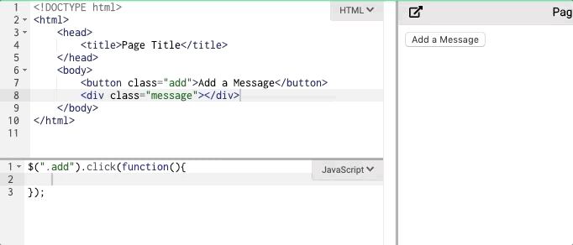
Using .append() to add HTML
$(".add").click(function(){
$(".message").append(`<p>New Message</p>`);
});
Notes:
Talk through what is happening in the gif

Slide 96
.append() with combined strings
字符串插值允许您组合字符串和变量以在JavaScript中构建HTML。
$("p").append(`Hello ${userName}.`);
string
variable
Notes:
Why is this useful? Emphasize that changing HTML from JS makes it so that we don’t have to display all the HTML from the get go and allows us to respond to user inputs
Allows us to combine information we've stored from the user any string

Slide 97
.append() with combined strings
Use backticks around the whole string and $ and { } around any variable.
$("button").click(function() {
let newItem = $("input").val();
$(".toDo").append(`<li> ${newItem} </li>`);
});
Notes:
Ask students what will show up on the webpage? What is newItem holding? What will newItem be replaced with in line 3?
Why is this useful? Emphasize that changing HTML from JS makes it so that we don’t have to display all the HTML from the get go and allows us to respond to user inputs

Slide 98
https://popcode.org/?snapshot=05aed423-535f-445c-adc3-da3db168a34d
Open popcode
使用.append（）将包含所有输入文本的新段落（<p>）添加到带有“ history”类的div的末尾。
修改漫画作业，让用户的话，不断叠加到下面的消息列表中
Notes:
Teacher Notes:
This is similar to the mad lib you did when creating variables, but this time you’re using input fields to type in responses.

Slide 99
How can I combine strings and variables to add HTML to my webpage?
Coders will…
use the .append() jQuery action and string interpolation to add HTML elements to a webpage.
Notes:
Say:
Remember, our goal today was to…
use the .append() jQuery action and string interpolation to add HTML elements to a webpage.

Slide 100
Which of the follow will add a new div with variable faveSnack to the webpage?
$("body").append(faveSnack);
$("body").append(<div>faveSnack</div>);
$("body").append(`<div>faveSnack</div>`);
$("body").append(`<div>$(faveSnack)</div>`);
$("body").append(`<div>${faveSnack}</div>`);
Notes:
Teacher Notes:
Students may need clarification on the directions: they should be writing just the javascript portion to retrieve the info from the input field.

Slide 101
帮助卡尔顿和他的伙伴一起旅行！建立一个网页，允许他将物品添加到他的装箱单中。
https://popcode.org/?snapshot=e0c3ae37-a0b7-4022-8310-e4cd6fad031a
Mild Medium Spicy

